Slide 1
YOLOv4: Optimal Speed and Accuracy of Object Detection
2020 arXiv
魏梓泉

Slide 2
Contributions
Mosaic data augmentation
Self Adversarial Training
CmBN –from CBN (Cross-iteration batch normalization)
Modified SAM
Modified PANet

Slide 3
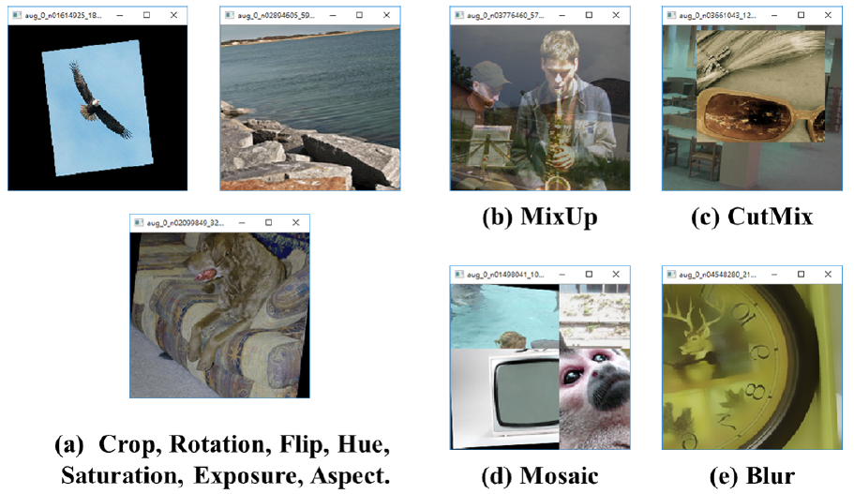
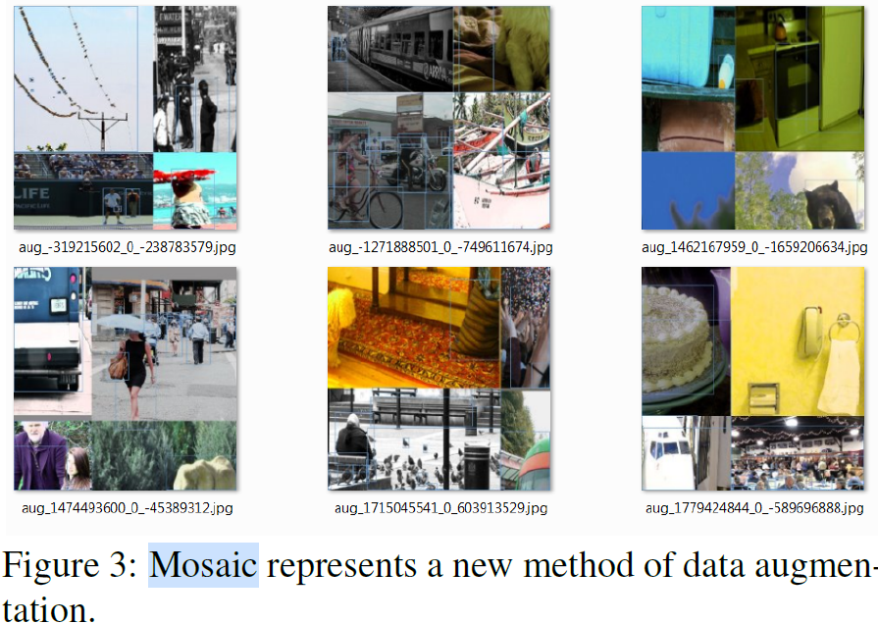
Mosaic data augmentation

Slide 4
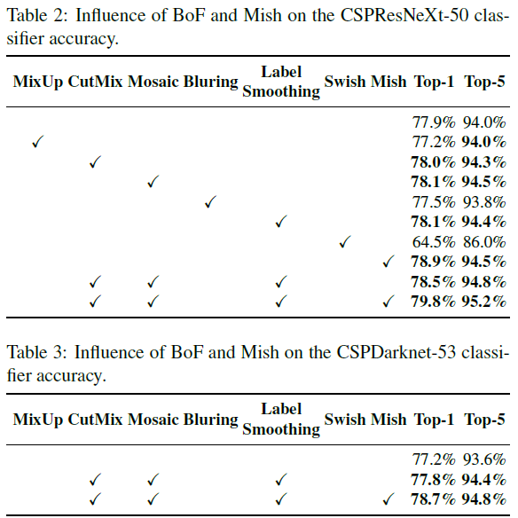

Slide 5
Self Adversarial Training –a data augmentation
In the 1st stage the neural network alters the original image instead of the network weights.
In the 2nd stage, the neural network is trained to detect an object on this modified image in the normal way
Original Image
Stylized Image
Adversarial attack

Slide 6
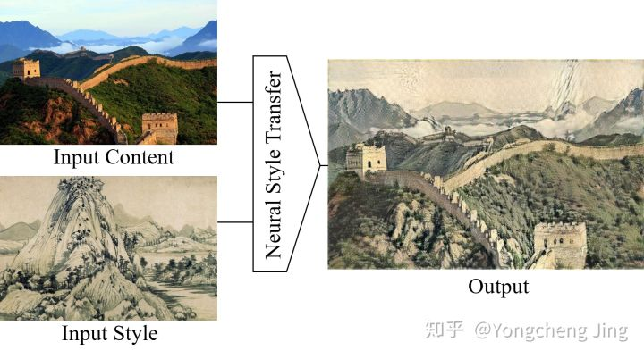
Neural Style Transfer (图像风格化)

Slide 7
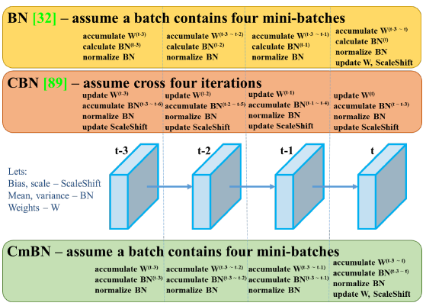
Cross mini-Batch Normalization (CmBN)

Slide 8
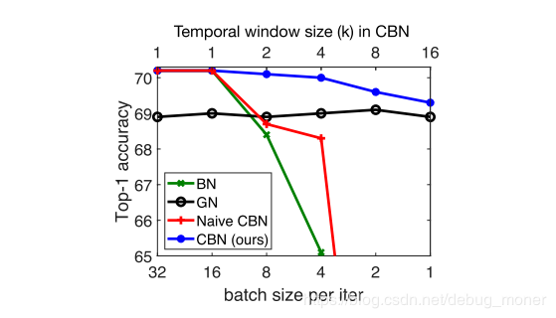
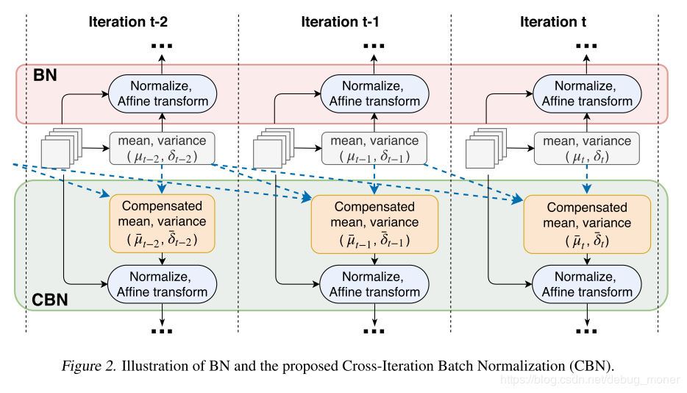
Cross-iteration Batch Normalization (CBN)

Slide 9
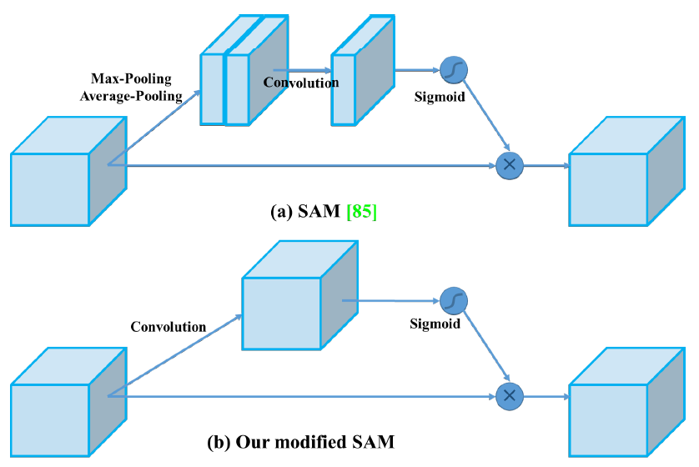
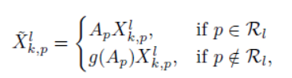
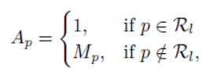
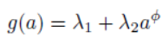
Modified SAM and PANet
SAM：如果某个点位于region之内，其值不变。如果位于background，其值乘以一个小于1的值，以此提高region的显著性
M
M
lamda1=0.5，lamda2=0.4, phi=4

Slide 10
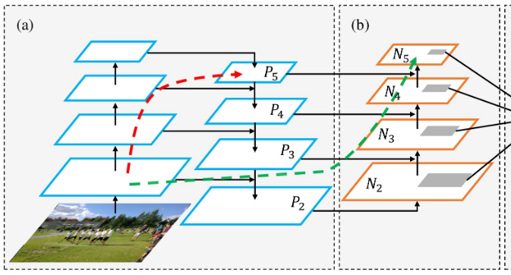
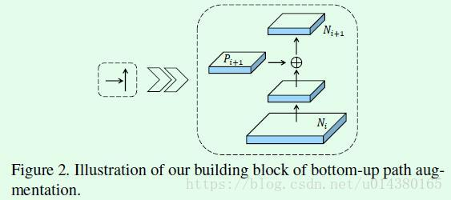
PANet

Slide 11
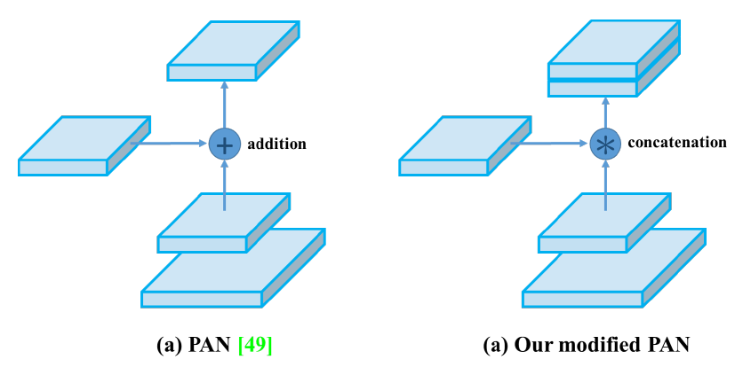
Modified SAM and PANet

Slide 12
The Structure of YOLOv4
Backbone: CSPDarknet53
Neck: SPP, PANet
Head: YOLOv3
CutMix and Mosaic data augmentation, DropBlock regularization, Class label smoothing
Mish activation, Cross-stage partial connections (CSP), Multiinput weighted residual connections (MiWRC)
CIoU-loss, CmBN, DropBlock regularization, Mosaic data augmentation, Self-Adversarial Training, Eliminate grid sensitivity, Using multiple anchors for a single ground truth, Cosine annealing scheduler, Optimal hyperparameters, Random training shapes
Mish activation, SPP-block, SAM-block, PAN path-aggregation block, DIoU-NMS
Tricks in YOLOv4

Slide 13
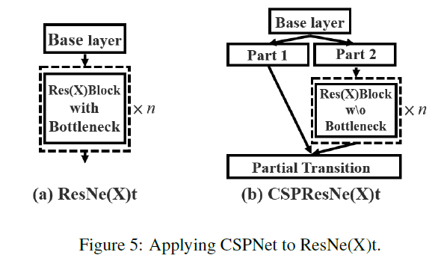
CSPDarknet53 with Cross-stage partial connections (CSP)
Darknet53

Slide 14
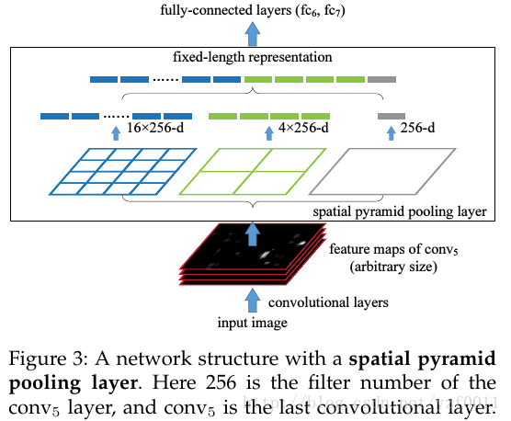
Spatial Pyramid Pooling (SPP)

Slide 15
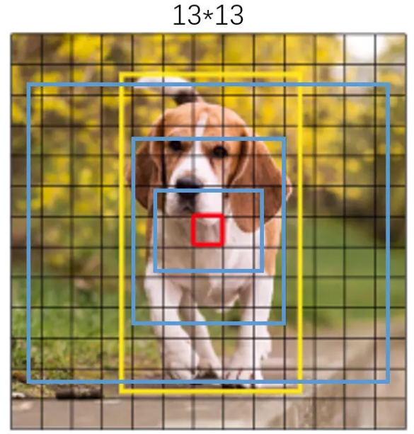
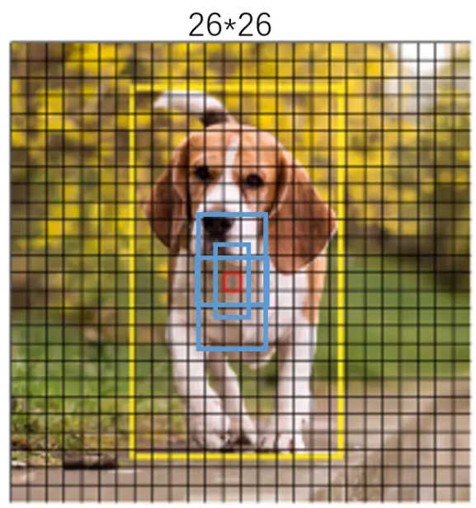
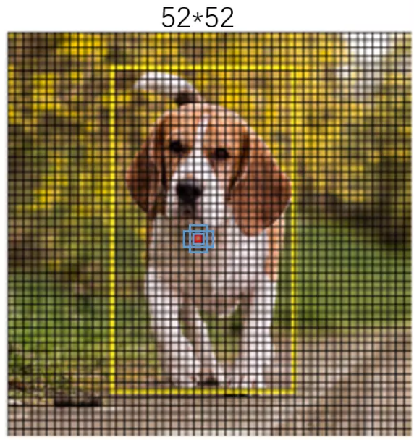
832 → 52
832 → 104
832 → 208
*4
*4
*4

Slide 16
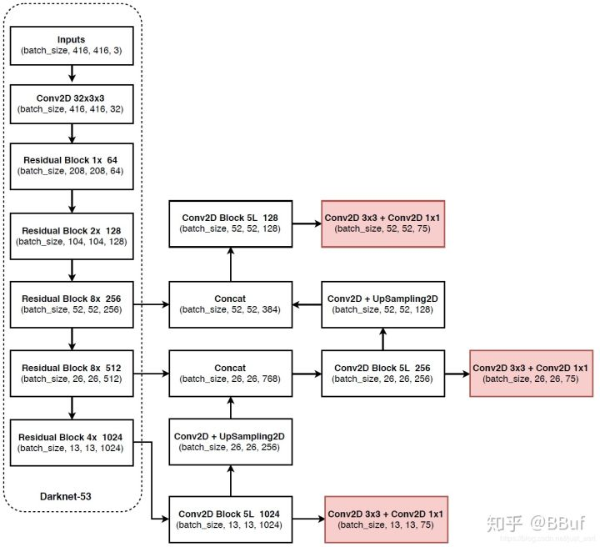
The Structure of YOLO v3
Head
输出尺寸的75代表3×(20+5)，其中20代表的是VOC数据集目标类别数，5代表的是每个目标预测框的 ，3代表的是某一个特征图的Anchor，也即先验框的数目。所以YOLOv3一共有9个Anchor，不过被平均分在了3个特征层中，这也实现了多尺度检测

Slide 17
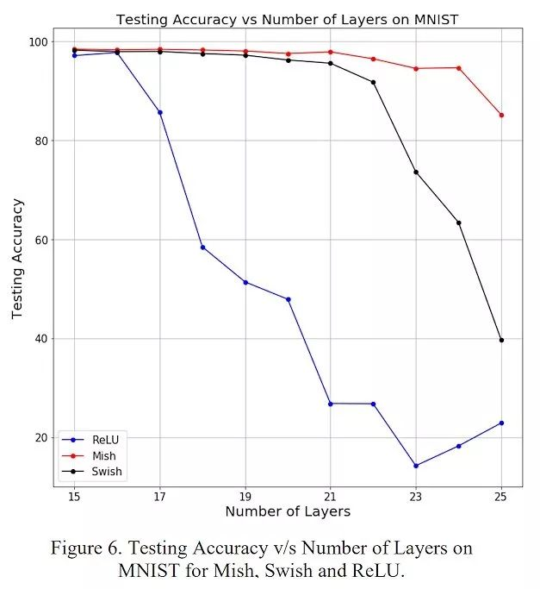
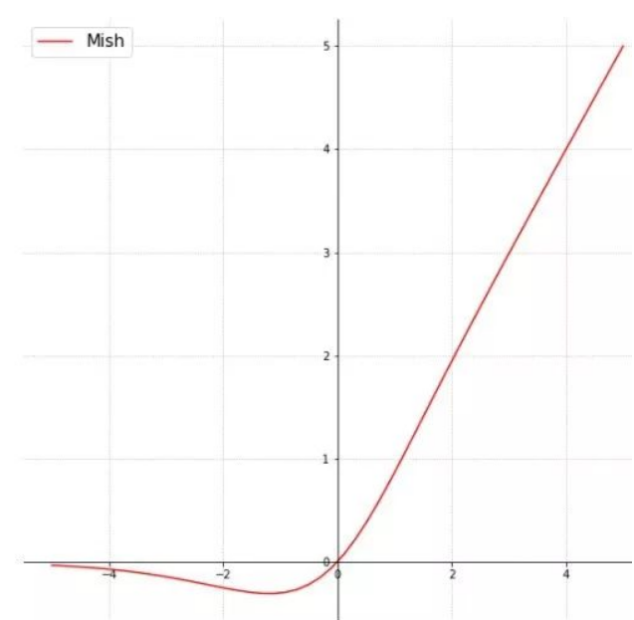
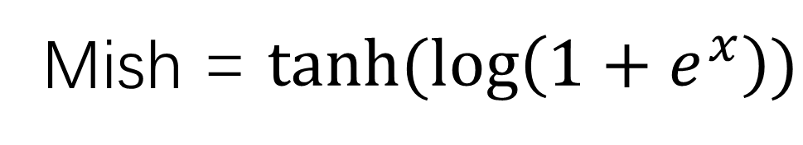
Mish activation
Mish = $tanh⁡(\log\left(1+e^{x}\right))$

Slide 18
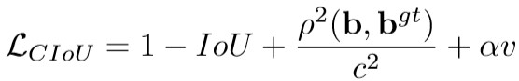
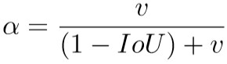
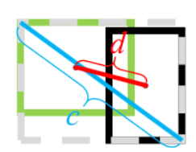
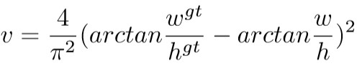
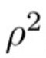
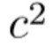
Complete IOU loss (CIOU loss)
是指predict box和GT box中心点的距离的平方,
是指刚好能包含predict box和GT box的最小box的对角线长度平方

Slide 19
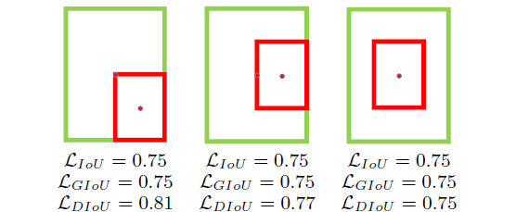
DIoU NMS
Replace IoU by DIoU in NMS stage.

Slide 20
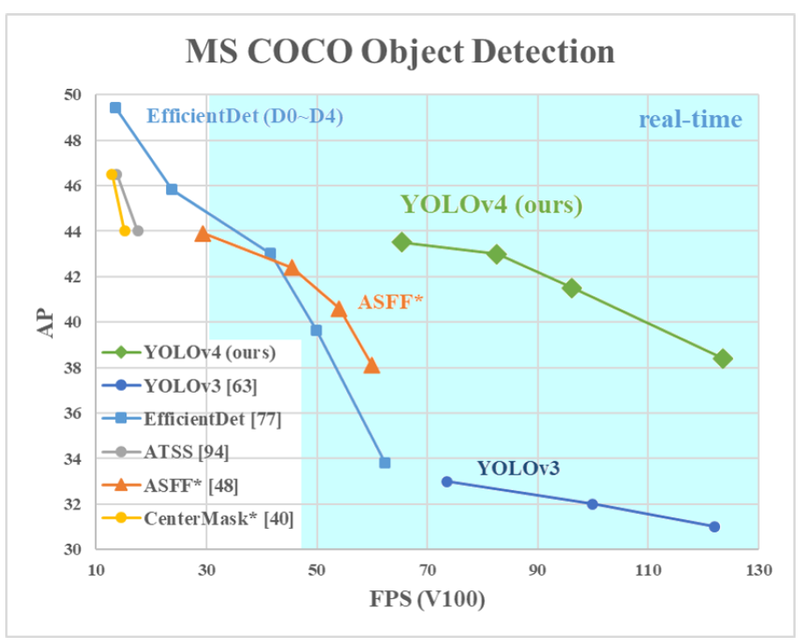
Performance

Slide 21
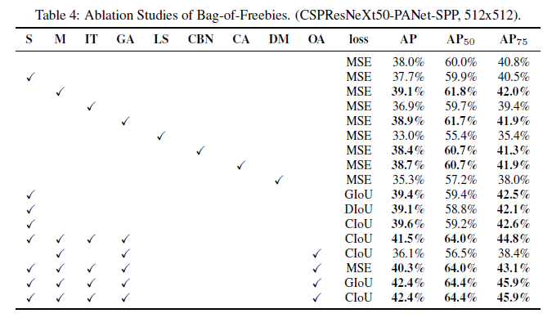
Ablation Studies

Slide 22
S: Eliminate grid sensitivity the equation bx = (tx)+cx; by = (ty)+cy, where cx and cy are always whole numbers, is used in YOLOv3 for evaluating the object coordinates, therefore, extremely high tx absolute values are required for the bx value approaching the cx or cx + 1 values. We solve this problem through multiplying the sigmoid by a factor exceeding 1.0, so eliminating the effect of grid on which the object is undetectable.
M: Mosaic data augmentation using the 4-image mosaic during training instead of single image
IT: IoU threshold - using multiple anchors for a single ground truth IoU (truth, anchor) > IoU threshold
GA: Genetic algorithms - using genetic algorithms for selecting the optimal hyperparameters during network training on the first 10% of time periods
LS: Class label smoothing - using class label smoothing for sigmoid activation
CBN: CmBN - using Cross mini-Batch Normalization for collecting statistics inside the entire batch, instead of collecting statistics inside a single mini-batch
CA: Cosine annealing scheduler - altering the learning rate during sinusoid training
DM: Dynamic mini-batch size - automatic increase of mini-batch size during small resolution training by using Random training shapes
OA: Optimized Anchors - using the optimized anchors for training with the 512x512 network resolution

Slide 23
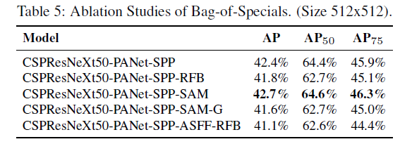
Ablation Studies

Slide 24
THANKS

